Slide 1
A Vital Conversation
Speaking about gun violence and proposed legislation
5-28-21

Slide 2
Proposed Amendment
to the Iowa Constitution
November 2022 election ballot

Slide 3
Proposed Amendment
to the Iowa Constitution
November 2022 election ballot
Iowans for Gun Safety urges you to vote NO in the interest of greater public safety.

Slide 4
Our Agenda:
Some clarifications
Gun safety: a public health issue
Gun violence and solutions that work
The proposed amendment would not be good for Iowa

Slide 5
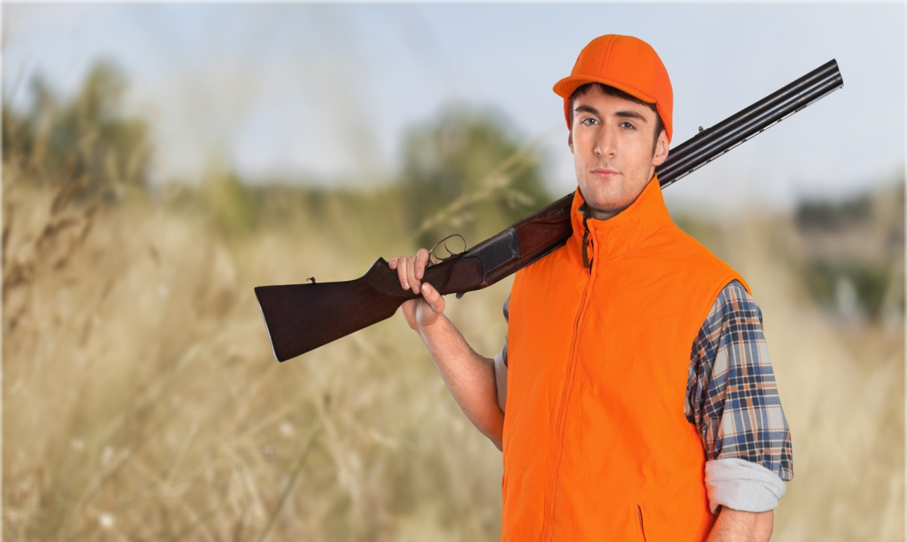
Iowans For Gun Safety
Our goal is to support policies that make gun ownership SAFER for all.
We are NOT against guns.
We are against gun violence.

Slide 6
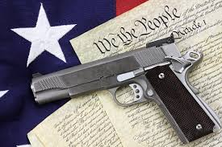
Clarification #1
Many people base their beliefs
about gun ownership on the
Federal Second Amendment.

Slide 7
Clarification #1
Many people base their beliefs
about gun ownership on the
Federal Second Amendment.
But what is proposed for Iowa is something different…

Slide 8
Clarification #2
NRA – claims 5 million members, but that’s only1.5% of all Americans
93% of all gun owners
and 80% of hunters
DO NOT BELONG TO THE NRA

Slide 9
Clarification #2
NRA – claims 5 million members, but that’s only1.5% of all Americans
Responsible Iowa gun owners support background checks, gun safety training, and requiring a license to carry a gun in public

Slide 10
Clarification #3
Gun lobbyists claim mental illness is the cause of gun violence.

Slide 11
Clarification #3
Gun lobbyists claim mental illness is the cause of gun violence.
Mental illness is a factor in gun violence only 4% of the time.
Guns are a factor in all forms of gun violence 100% of the time.

Slide 12
Clarification #3
Gun lobbyists claim mental illness is the cause of gun violence.
Mental illness IS an important factor in suicide.
This is why families and police need to be able to temporarily remove guns from people who exhibit suicidal inclinations (Extreme Risk Protection Orders).

Slide 13
Clarification #4
72% of Americans want to create an “extreme risk protection order” law that allows police or family members to request that a judge temporarily remove guns from people who may be a danger to themselves or others
.
83% of Americans want to require background checks for gun purchases at gun shows and other private sales
People who are gun owners believe we need stronger gun laws.

Slide 14
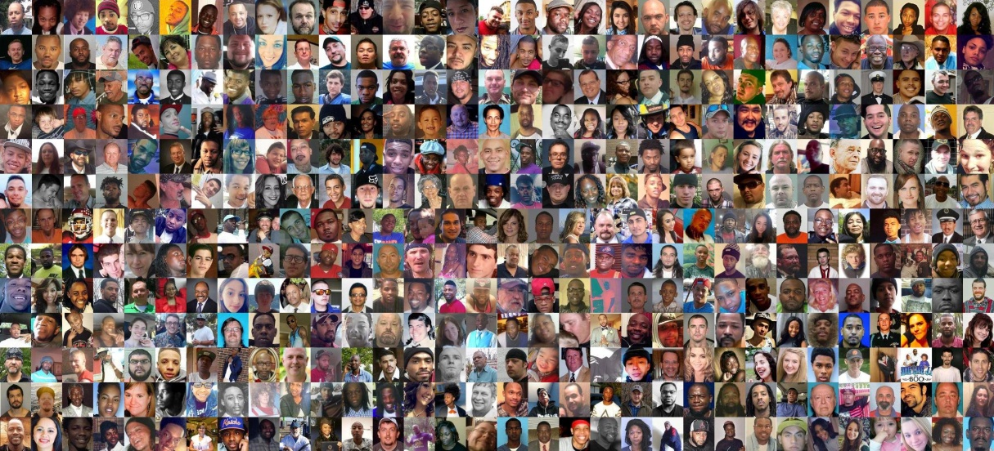
A public health issue…

Slide 15
A public health issue…
1 American is shot every 5 minutes.
1 American dies by gunfire every 14 minutes.
323 Americans are shot and 104 die EVERY DAY

Slide 16
A public health issue…
Nationally:
2nd cause of death for all children and youth.
1st cause of death for young African American men.
Women are 21 TIMES more likely to be murdered with a gun in the USA than in other high-income countries.
BUT…
In the states that require a background check before every handgun sale, 46% fewer women
are shot to death by domestic partners.

Slide 17
A public health issue…
Nationally:
2nd cause of death for all children and youth.
1st cause of death for young African American men.
Women are 21 TIMES more likely to be murdered with a gun in the USA than in other high-income countries.
Here in Iowa, in an average year 281 people die by guns. 79% of all gun deaths in Iowa are suicides (221 yearly).

Slide 18

A public health issue…
67% of gun owners cite PERSONAL PROTECTION
as the primary reason they buy a gun.
BUT a gun in your home is 22 times more likely to injure or kill a family member than to be used
in self-defense.
AND women living in a home with a gun are
5 times more likely to be murdered by a domestic partner.

Slide 19


Solutions that work…
A public health point of view
individual
rights, behaviors
the safety of
all of us

Slide 20
Solutions that work…
A public health point of view
individual
rights, behaviors
the safety of
all of us

Slide 21
Solutions that work…
2) Evidence-based legislation

Slide 22
Solutions that work…
Consider how many lives have been spared as a result of:
vehicle safety standards
seat belts
child safety seats
air bags
speed limits, blood alcohol, etc…
without confiscating cars.

Slide 23
Solutions that work…
Consider how many lives have been spared as a result of:
vehicle safety standards
seat belts
child safety seats
air bags
speed limits, blood alcohol, etc…
We can do the same with guns…

Slide 24
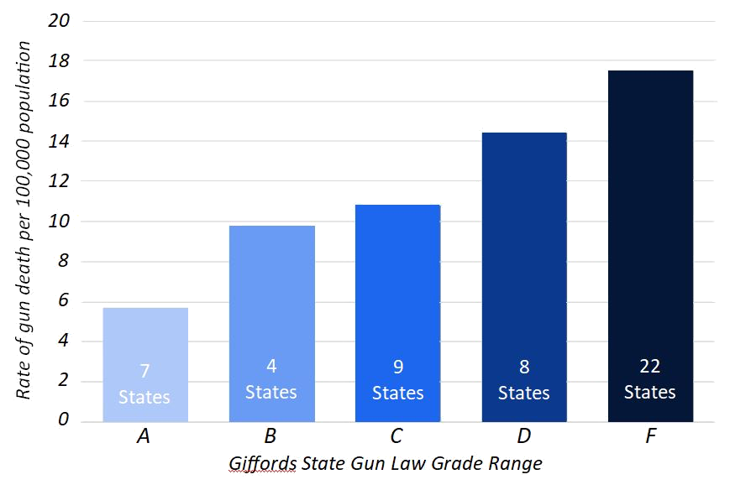
The states with the strongest gun laws have the lowest rates of gun violence.

Slide 25
Proposed amendment…
“The right of the people to keep and bear arms shall not be infringed. The sovereign state of Iowa affirms and recognizes this right to be a fundamental individual right. Any and all restrictions to this right shall be subject to strict scrutiny.”

Slide 26
STRICT SCRUTINY IS NOT PART OF THE
FEDERAL 2nd AMENDMENT
Proposed amendment…
“The right of the people to keep and bear arms shall not be infringed. The sovereign state of Iowa affirms and recognizes this right to be a fundamental individual right. Any and all restrictions to this right shall be subject to strict scrutiny.”

Slide 27
Not the same…

Slide 28
Strict Scrutiny amendments
have been adopted by only 3 states: Alabama, Missouri, Louisiana—
NOT great role models!

Slide 29
What does “strict scrutiny” mean?
Judges would be legally compelled to opt in favor of the least restrictive interpretation of gun laws.

Slide 30
What does “strict scrutiny” mean?
Judges would be legally compelled to opt in favor of the least restrictive interpretation of gun laws.
Louisiana case: Convicted felon caught with guns (handgun, AK-47)

Slide 31
What does “strict scrutiny” mean?
Judges would be legally compelled to opt in favor of the least restrictive interpretation of gun laws.
Louisiana case: Convicted felon caught with guns (handgun, AK-47)
case dismissed!

Slide 32
Strict Scrutiny gun rights amendments…
have been adopted by only 3 states: Alabama, Louisiana, Missouri-
NOT great role models!
are likely to undermine state and local gun violence prevention laws

Slide 33
By a nearly 2-to-1 margin, more Iowa voters oppose a “strict scrutiny” amendment than support it.
January 2019 - SurveyUSA

Slide 34
By a nearly 2-to-1 margin, more Iowa voters oppose a “strict scrutiny” amendment than support it.
January 2019 - SurveyUSA
“After the potential implications of the amendment were explained, 54% indicated opposition to the proposal, compared to just 28% indicating support.”

Slide 35
Your NO vote is a vote for greater safety— for yourself, your family, and everyone in your community.
Your NO vote will keep future decision-making about gun safety in our hands.
Keep the Conversation Alive Vote NO

Slide 36
A Call To Action
WE NEED YOU
1. Call your family, friends and neighbors and inform them. Ask them to vote against this “strict scrutiny” amendment.
2. Support Iowans for Gun Safety with your contributions to help communicate this message.
3. Join Iowans for Gun Safety to receive up-to-date information on gun violence prevention actions you can take.
iowansforgunsafety.org

Slide 37
Questions?
Contact us at: IowansForGunSafety.org

